Slide 1
Time Series

Slide 2
Topics covered so far
Time Series
Introduction
Decomposition
Stationarity
Autoregressive models
Moving Average models
ARMA
ARIMA

Slide 3
Discussion questions
What is a time series and what are the features of a time series?
What is decomposition of time series and why do we do decomposition?
How do you define a stationary time series and how do we check stationarity?
What is the difference between Autoregressive and Moving Average models?
What do you understand by ARMA & ARIMA models?

Slide 4
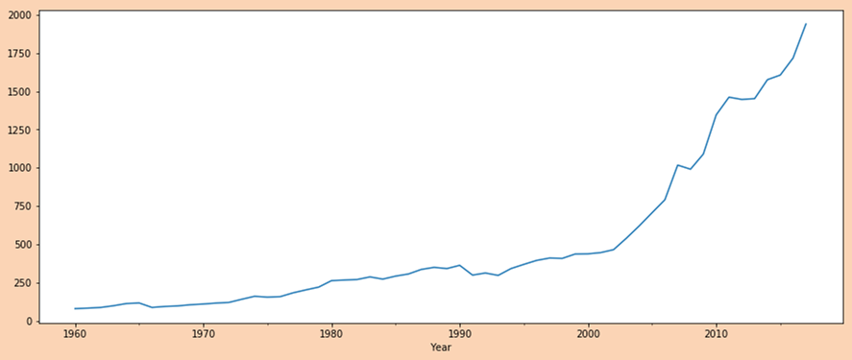
Time Series
A time series is a sequence of measurements on the same variable collected over time.
The measurements are made at regular time intervals.
Examples include - predicting the number of churning customers, explaining seasonal patterns in sales, etc.
What is not a time series?
Data collected on multiple items at the same point of time. For eg, dow jones average on a single day
When the time periods are not the same. for e.g. in a single time series both quarterly and yearly data
Features of a time series: The following are the features of a time series-
Data is not independent
Ordering is very important because there is dependency and changing the order will change the data structure
Yearly time series of per capita GDP of India

Slide 5
Decomposition of a Time Series
Decomposition refers to the task of deconstructing the time series into several components like trend, seasonality etc.
There are two types of models used to decompose time series-
Additive model: It is useful when the seasonal variation is relatively constant over time.
Observation = Trend + Seasonality + Error
Multiplicative model: It is more realistic in nature and can be used when there are some variations over time
Observation = Trend * Seasonality * Error
Why do we need to decompose a time series:
To compare the long-term movement of the series (Trend) vis-a-vis short-term movement (seasonality) to understand which has the higher influence
To compare it amongst multiple sectors to avoid non-uniformity

Slide 6
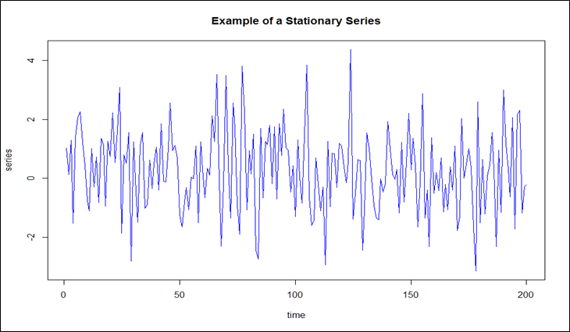
Stationary Time Series
In time series analysis, stationarity is a characteristic property of having constant statistical measures such as mean, variance, co-variance etc over a period of time.
In other words, a time series is said to be stationary if the marginal distribution of y at a time p(yt) is the same at any other point in time. For time series analysis to be performed on a dataset, it should be stationary.
It is also known as white noise.
We can check the stationarity
By visualizing the rolling mean and standard deviation of the series
By using the Augmented Dickey-Fuller test

Slide 7

Autoregressive model vs Moving Average Model
Autoregressive models: Autoregressive models are based on the idea that the current value of the series, yₜ , can be explained as a linear combination of p past values, y_{t−1}, y_{t−2}, . . . , y_{t−p} of the same series.
An autoregressive model of order p, abbreviated AR(p), is of the form
The simplest AR process is AR(0), which has no dependence between the terms. In fact, AR(0) is essentially white noise. If y depends on more than one of its previous values then it is denoted by p parameters.
Moving Average models: While the autoregressive model considered the past values of the target variable for prediction, Moving average makes use of the white noise error terms. It can be represented as follows:
Where, εt, εt−1,…, εt−q are the white noise error terms.

Slide 8
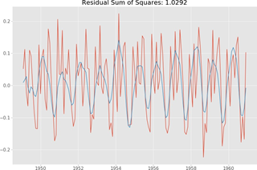
ARMA Model
The Autoregressive Moving Average model is a combination of the autoregressive model and the moving average model which uses both the past values as well as the error terms to predict for the future time series.
If the process has terms from both an AR(p) and MA(q) process, then the process ARMA(p, q) can be expressed as
The ARMA model makes use of 2 parameters as given below:
p: Lag order or the number of past orders to be included in the model
q: The order of moving average
This plot shows the ARMA model fitted on the air passenger dataset. It gives the Residual Sum of Squares as 1.0292.
Source

Slide 9
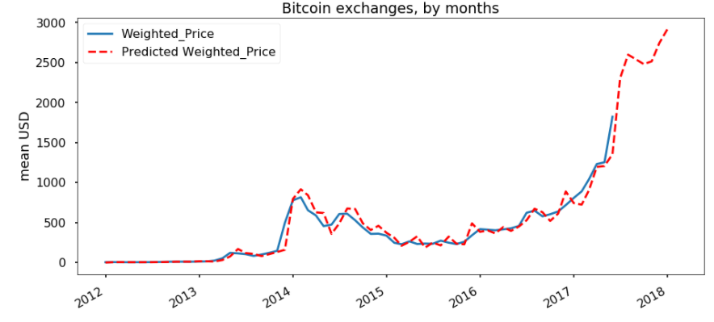
ARIMA Model
ARIMA stands for AutoRegressive Integrated Moving Average. It is a generalization of ARMA model and adds the notion of integration. The ARIMA model makes use of 3 parameters, which are given below:
p: Lag order or the number of past orders to be included in the model
d: The number of times differencing was applied in the original series in order to make the series stationary.
q: The order of moving average
This plot shows the ARIMA model fitted on the bitcoin price prediction dataset.

Slide 10
Case Study

